Slide 1
Matrix Multiplication and faster parallel algorithm for HPC
Sung Eun Bae
sung.bae@canterbury.ac.nz

Slide 2

Matrix multiplication
Fundamental computation: physics, computer graphics, statistics, applied mathematics, engineering…
Data size is ever growing
Review currently available technology to be exa-scale ready

Slide 3
Matrix multiplication
For n*n matrix, each element takes n multiplications and n additions.
Naïve algorithm will require n³ multiplications and n³ additions. ie. O(n³) time

Slide 4
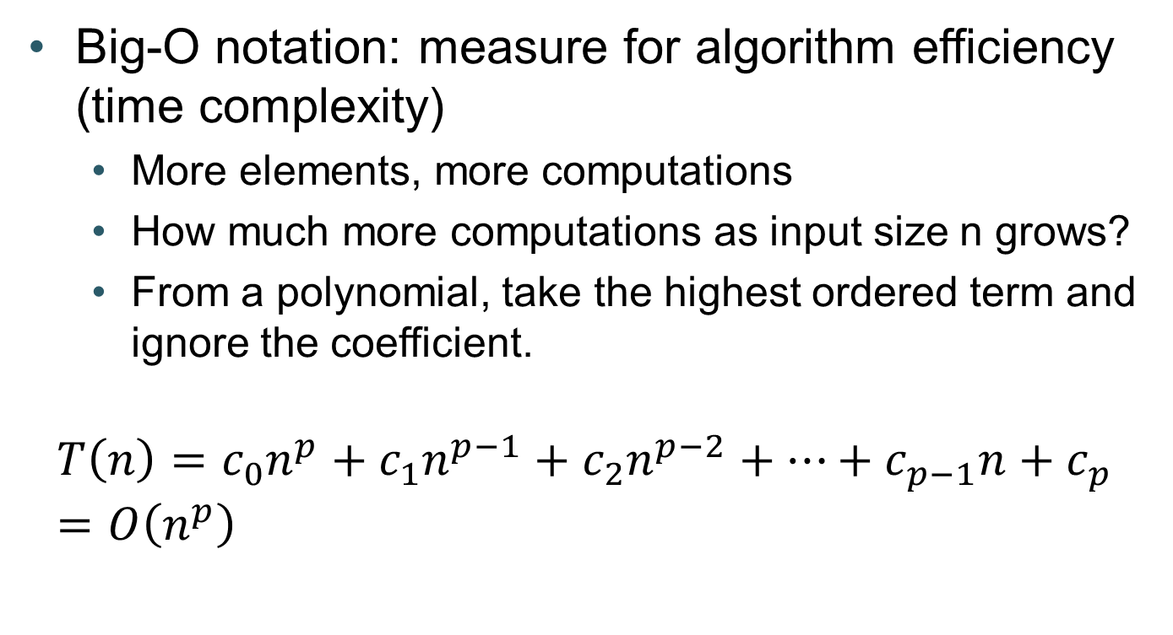
O(n³) ????
Big-O notation: measure for algorithm efficiency (time complexity)
More elements, more computations
How much more computations as input size n grows?
From a polynomial, take the highest ordered term and ignore the coefficient.
$$T\left(n\right)={c_{0}n}^{p}+{c_{1}n}^{p−1}+{c_{2}n}^{p−2}+…+c_{p−1}n+c_{p} \\ =O\left(n^{p}\right)$$

Slide 5
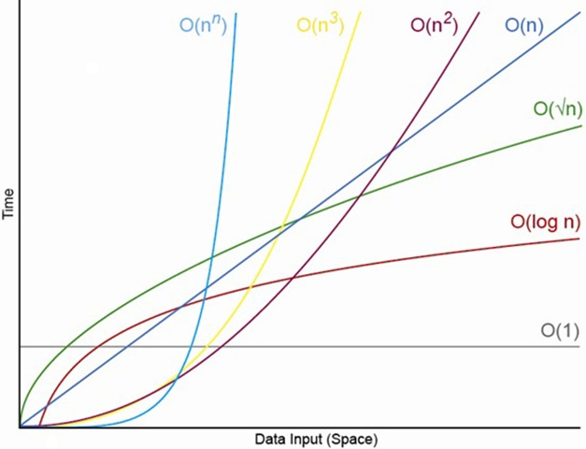
Is O(n³) fast then?
Naïve algorithm measured
(Core i7 3520M @ 2.90Ghz, gcc 4.8.2)
When n doubles, the time increases by 7~10 times. (2³ times in theory)
Not efficient for a large matrix
n | 256 | 512 | 1024 | 2048 | 4096
secs | 0.0526 | 0.342 | 3.16 | 32.5 | 320

Slide 6
Can we do better than O(n³)?
Strassen algorithm (1969)
Define new matrices
8 multiplications, 4 additions
8 additions only
7 multiplications, 18 additions
O(n^{2.807}) !!!!
7 multiplications, 10 additions

Slide 7
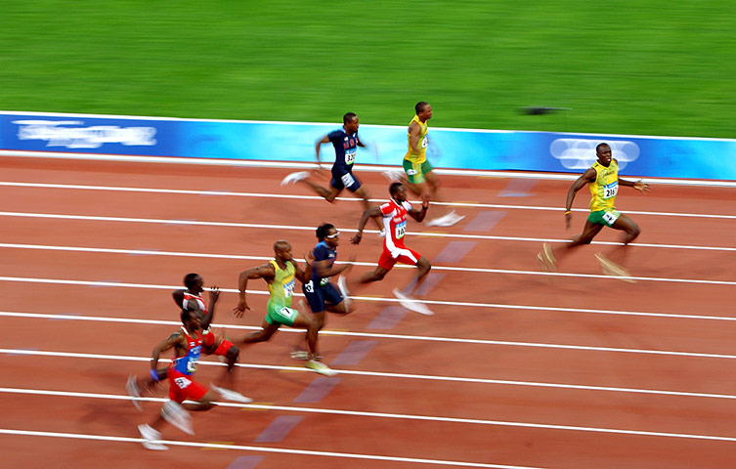
History of faster matrix multiplications
O(n³) – Naïve
O(n^{2.807}) – Strassen (1969)
O(n^{2.376}) – Coppersmith & Winograd (1987)
O(n^{2.3737}) – Stother (2010)
O(n^{2.3727}) – Williams (2011)

Slide 8
When you need matrix multiplication…
Don’t implement, use BLAS (Basic Linear Algebra Subprograms)
Many implementations – BLAS (NetLib), ATLAS, gotoBLAS2, ESSL(IBM), MKL(Intel), ACML(AMD) etc.
Original BLAS: Not well-tuned
ATLAS, MKL, ESSL, gotoBLAS2: highly tuned, but not necessarily employing better algorithms
Supports multithreaded computation (free parallelism with multicore)

Slide 9
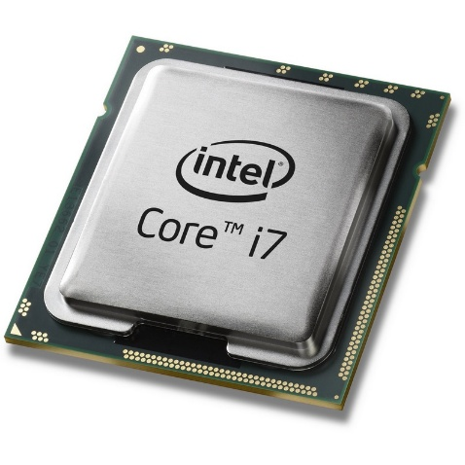
Parallel computation
Multithreads: utilize multi-core CPUs
very simple, but scale-up is limited by number of maximum number of threads supported by CPU
thread 1
thread 2
thread 3

Slide 10
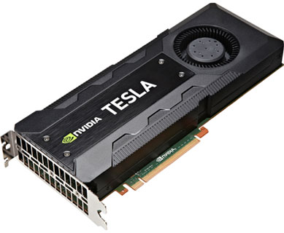
BLAS + GPU = cuBLAS
Not complete..will add more info here

Slide 11
A parallel algorithm
Multi-threads and GPU may be sufficient for many applications
But what if you need more?
Are there parallel algorithms?
Cannon’s algorithm (1969)…
(quiet)

Slide 12
Cannon’s algorithm
 |  |  |  |  |  |  | r
STEP | 0 |  |  |  |  | q | o
 |  |  |  |  | p | n | l
 |  |  |  |  | m | k
 |  |  |  |  | j
 |  | c | b | a
 | f | e | d
i | h | g

Slide 13
Cannon’s algorithm
STEP | 1 |  |  |  |  |  | r
 |  |  |  |  |  | q | o
 |  |  |  |  | p | n | l
 |  |  |  |  | m | k
 |  |  | c | b | a,j
 |  |  |  |  | aj
 |  | f | e | d
 | i | h | g

Slide 14
Cannon’s algorithm
STEP | 2
 |  |  |  |  |  |  | r
 |  |  |  |  |  | q | o
 |  |  |  |  | p | n | l
 |  |  |  | c | b,m | a,k
 |  |  |  |  | aj+bm | ak
 |  |  | f | e | d,j
 |  |  |  |  | dj
 |  | i | h | g

Slide 15
Cannon’s algorithm
STEP | 3
 |  |  |  |  |  |  | r
 |  |  |  |  |  | q | o
 |  |  |  |  | c,p | b,n | a,l
 |  |  |  |  | aj+bm+cp | ak+bn | al
 |  |  |  | f | e,m | d,k
 |  |  |  |  | dj+em
 |  |  | i | h | g,j
 |  |  |  |  | gj

Slide 16
Cannon’s algorithm
STEP | 4
 |  |  |  |  |  |  | r
 |  |  |  |  |  | c,q | b,o
 |  |  |  |  | aj+bm+cp | ak+bn+cq | al+bo
 |  |  |  |  | f,p | e,n | d,l
 |  |  |  |  | dj+em+fp | dk+en | dl
 |  |  |  | i | h,m | g,k
 |  |  |  |  | gj+hm | gk

Slide 17
Cannon’s algorithm
STEP | 5
 |  |  |  |  |  |  | c,r
 |  |  |  |  | aj+bm+cp | ak+bn+cq | al+bo+cr
 |  |  |  |  |  | f,q | e,o
 |  |  |  |  | dj+em+fp | dk+en+fq | dl+eo
 |  |  |  |  | i,p | h,n | g,l
 |  |  |  |  | gj+hm+ip | gk+hn | gl

Slide 18
Cannon’s algorithm
STEP | 6
 |  |  |  |  | aj+bm+cp | ak+bn+cq | al+bo+cr
 |  |  |  |  |  |  | f,r
 |  |  |  |  | dj+em+fp | dk+en+fq | dl+eo+fr
 |  |  |  |  |  | i,q | h,o
 |  |  |  |  | gj+hm+ip | gk+hn+iq | gl+ho

Slide 19
Cannon’s algorithm
STEP | 7
 |  |  |  |  | aj+bm+cp | ak+bn+cq | al+bo+cr
 |  |  |  |  | dj+em+fp | dk+en+fq | dl+eo+fr
 |  |  |  |  |  |  | i,r
 |  |  |  |  | gj+hm+ip | gk+hn+iq | gl+ho+ir

Slide 20
Cannon’s algorithm
 |  |  |  |  |  |  | r
STEP | 0 |  |  |  |  | q | o
 |  |  |  |  | p | n | l
 |  |  |  |  | m | k
 |  |  |  |  | j
 |  | c | b | a
 | f | e | d
i | h | g
Total 3n-2 steps

Slide 21

Room for improvement?
Step 1
Step 2
Step 3
a,j
aj
b,m | a,k
aj+bm | ak
d,j
dj
c,p | b,n | a,l
aj+bm+cp | ak+bn | al
e,m | d,k
dj+em
g,j
gj
Step 4
WE NEED BETTER MANAGEMENT!
 | c,q | b,o
aj+bm+cp | ak+bn+cq | al+bo
f,p | e,n | d,l
dj+em+fp | dk+en | dl
h,m | g,k
gj+hm | gk

Slide 22
NEW: Duplex Cannon’s Algorithm
Data loaded from top-left AND bottom-right
Original
New
3n-2 steps
1.5n-2 steps

Slide 23
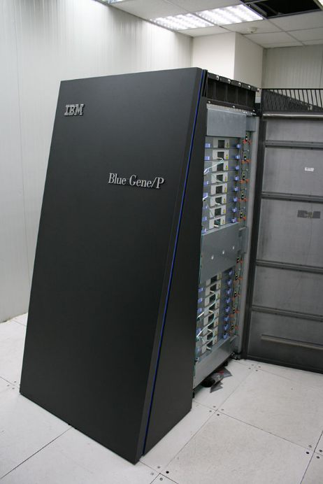
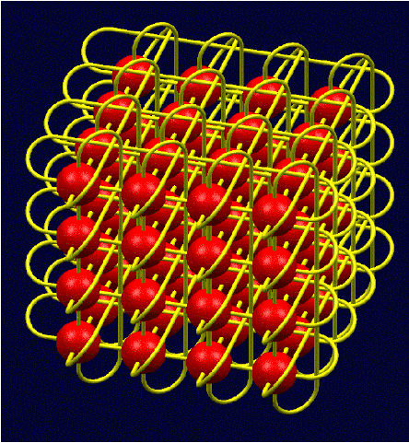
Experiment on BlueGene/P
Q: Why BlueGene/P?
A: 8192 cores connected in 3d torus topology with very fast interconnect

Slide 24
Results : Single core
1024x1024 matrices
 | Time (s)
Naïve (-O2) | 16.75s | -O2 -qtune=450 -qarch=450
Naïve (-O3) | 6.28s | -O3 –qstrict –qtune=450 –qarch=450
Naïve (-O3 with Double Hummer :SIMD code for double FPUs) | 3.46s | -O3 –qstrict –qtune=450 -qarch=450d
Strassen/Winograd (IBM ESSL DGEMM) | 0.84s | -O3 –qhot –qtune=450 -qarch=450d

Slide 25
Results : Single core
8192x8192 matrices
 | Time (s)
Naïve (-O2) |  | -O2 -qtune=450 -qarch=450
Naïve (-O3) |  | -O3 –qstrict –qtune=450 –qarch=450
Naïve (-O3 with Double Hummer :SIMD code for double FPUs) |  | -O3 –qstrict –qtune=450 -qarch=450d
Strassen/Winograd (IBM ESSL DGEMM) |  | -O3 –qhot –qtune=450 -qarch=450d
Not complete.to be updated

Slide 26
Results : Parallel
 | 8192x8192 | 16384x16384 | 131072x131072 | 262144x262144
Cannon | 11.4s (256) 2.89s(1024) | 89.8s(256) 23.2s(1024) | - | -
Cannon+ESSL DGEMM | 0.69s (256) 0.36s(1024) | 4.24s(256) 1.79s(1024) | 466.39s(1024) | 3511.05s(1024)
New | (to be completed)
New+ESSL DGEMM | (to be completed)

